Slide 1


AIBG X - Topic
Topic presentation

Slide 2
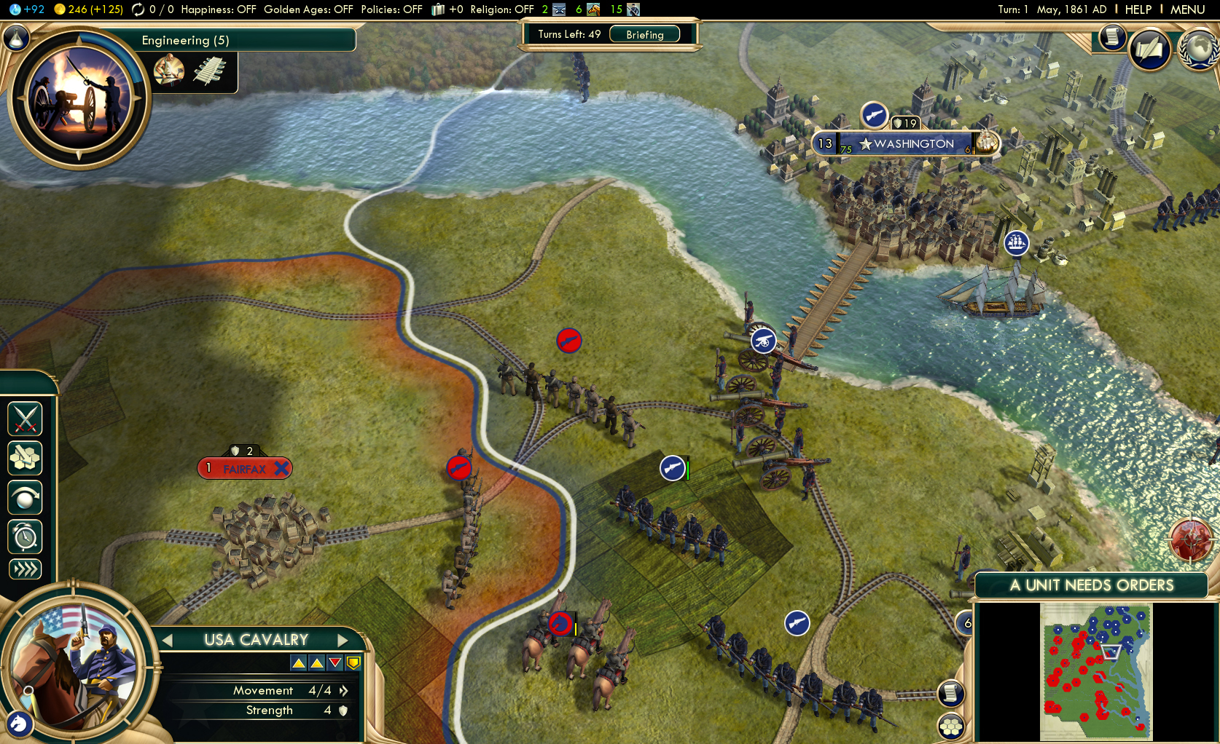
Inspiracija

Slide 3
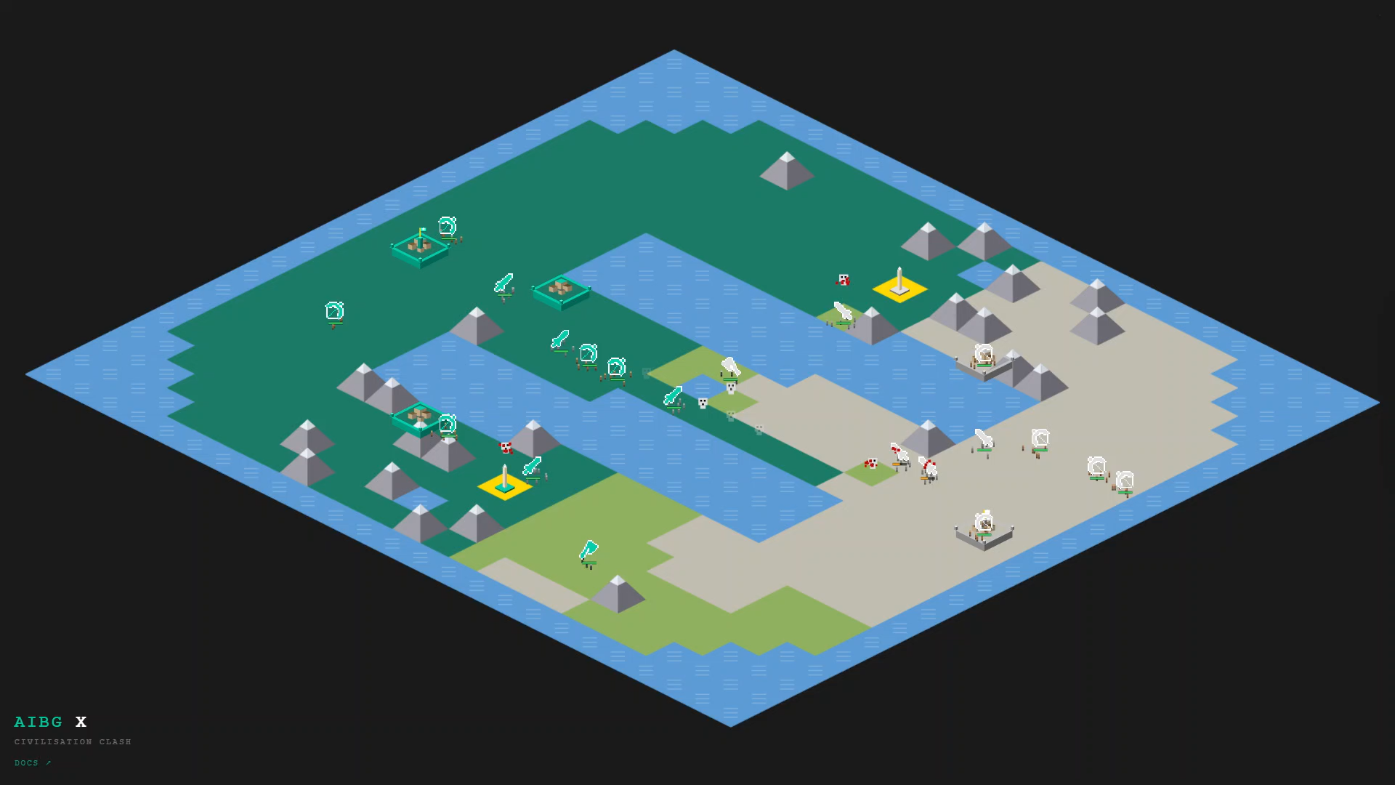
Civilization Clash

Slide 4
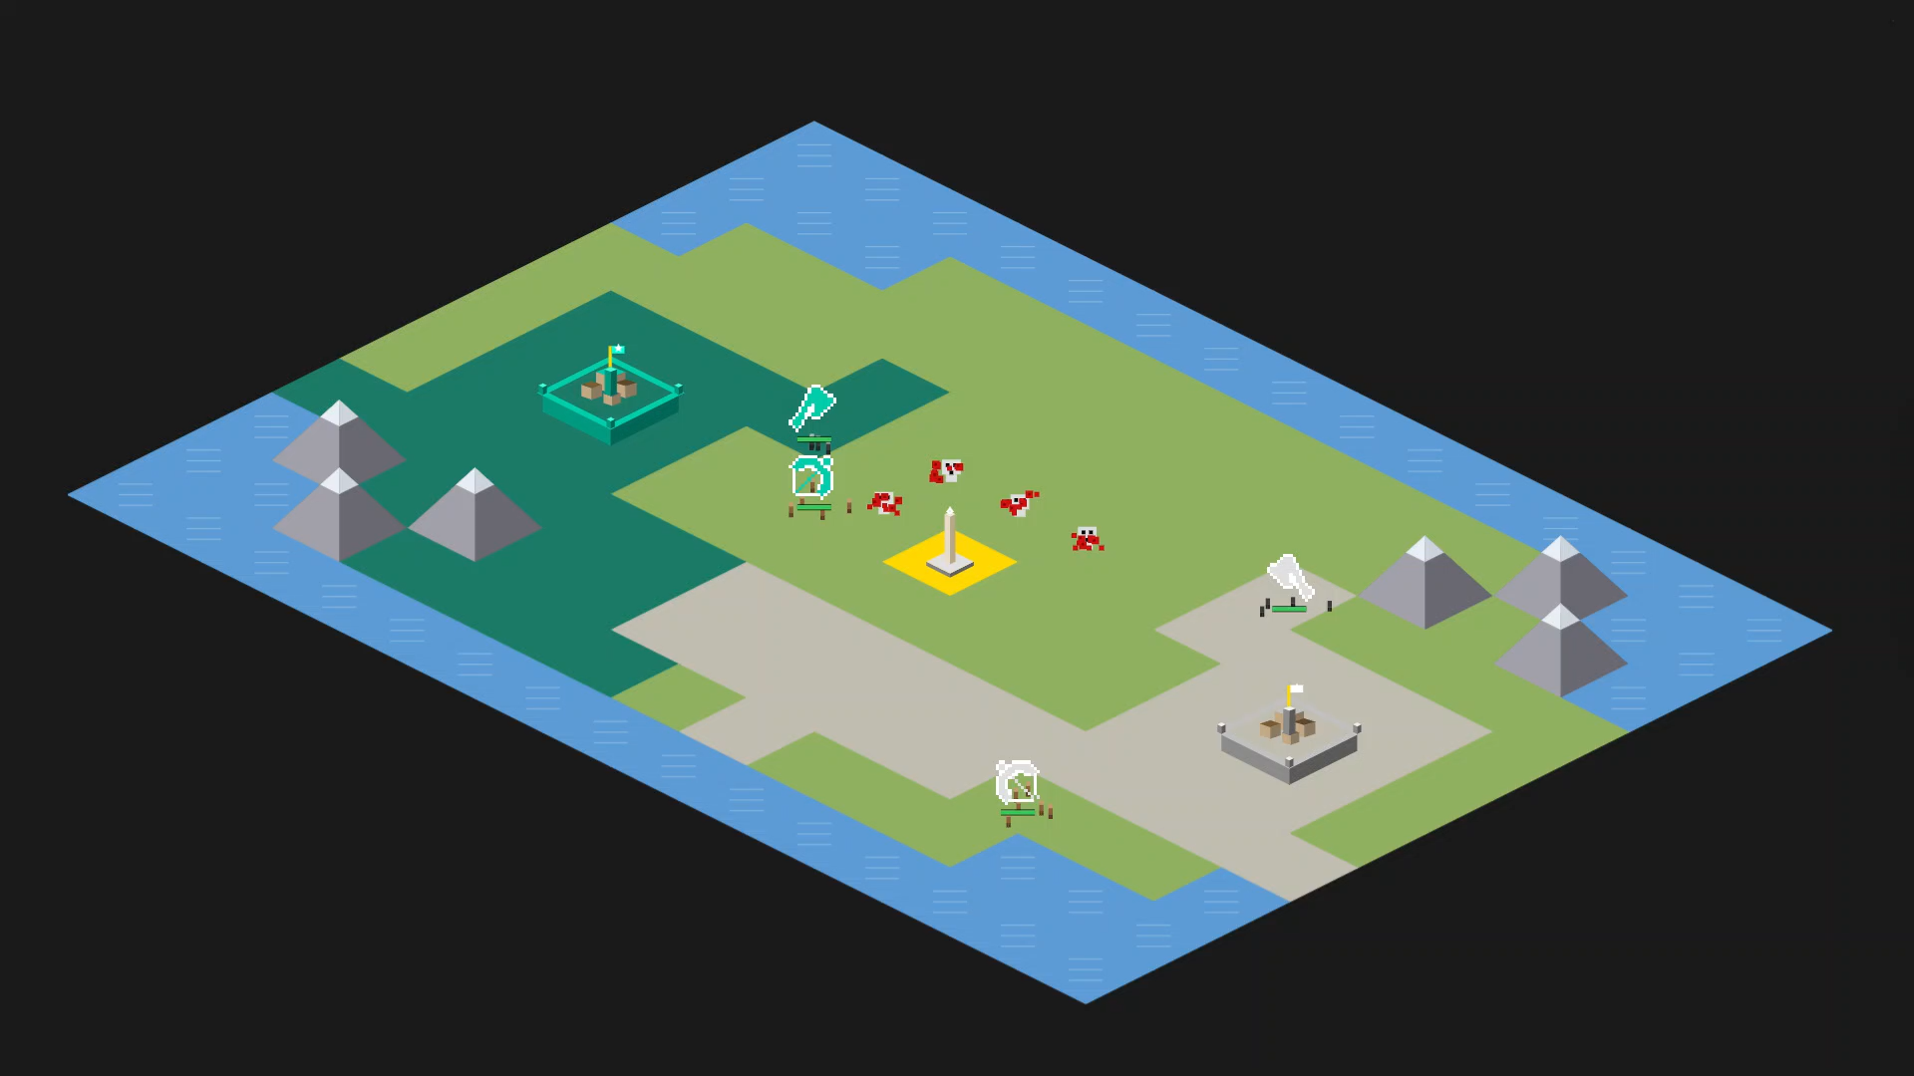
Civilization clash
2 civilizations at war (teal & white)
tactial turn-based game
players submit their inputs every turn
each player owns: territory, cities, an army
victory through domination or score (time limit)

Slide 5
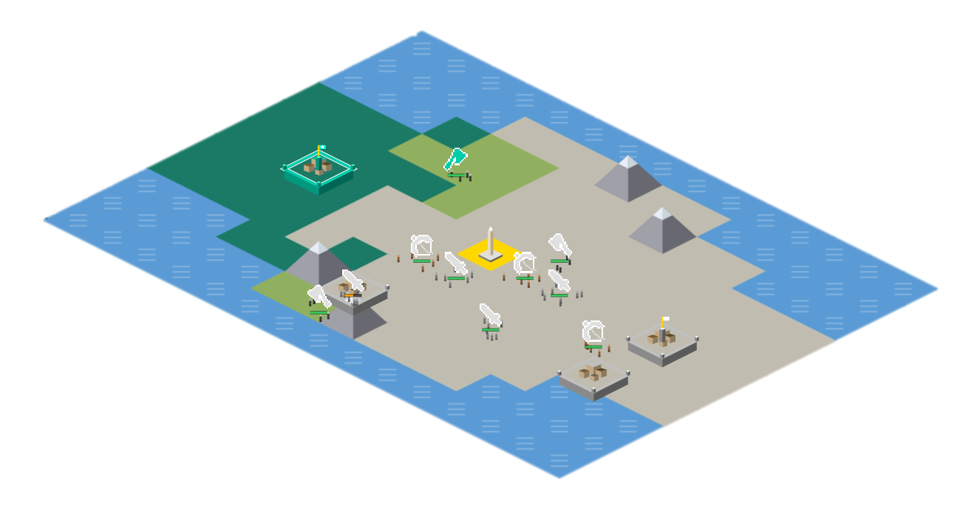
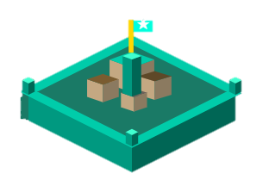
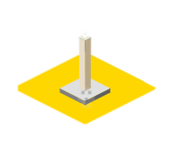




Map shape
Special tiles
Army
Economy scaling
Partial information

Slide 6



Tile types
5G to take
+0.5G /turn
Impassable
Economy
+5G / turn

Slide 7
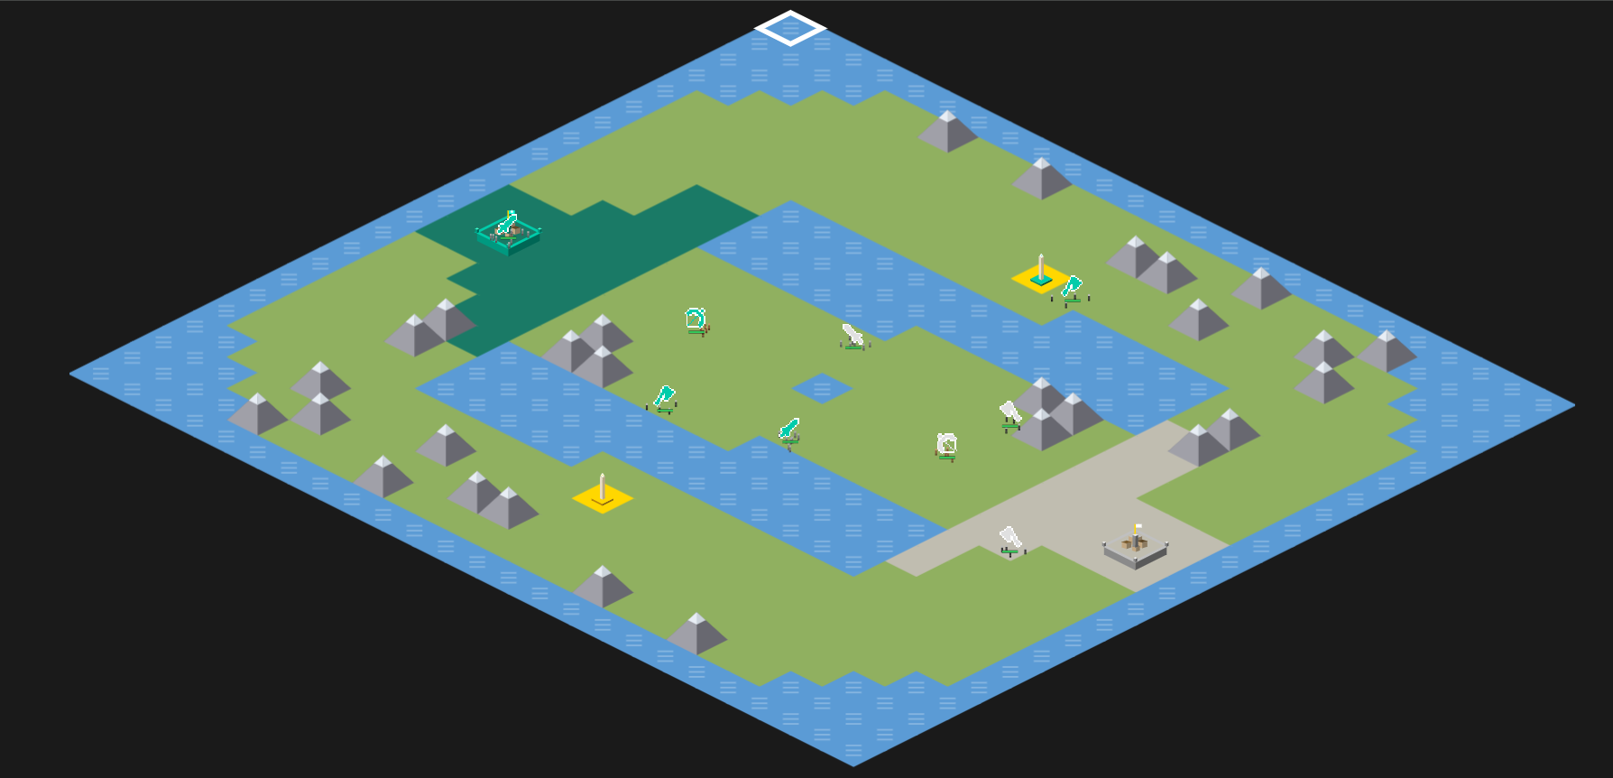
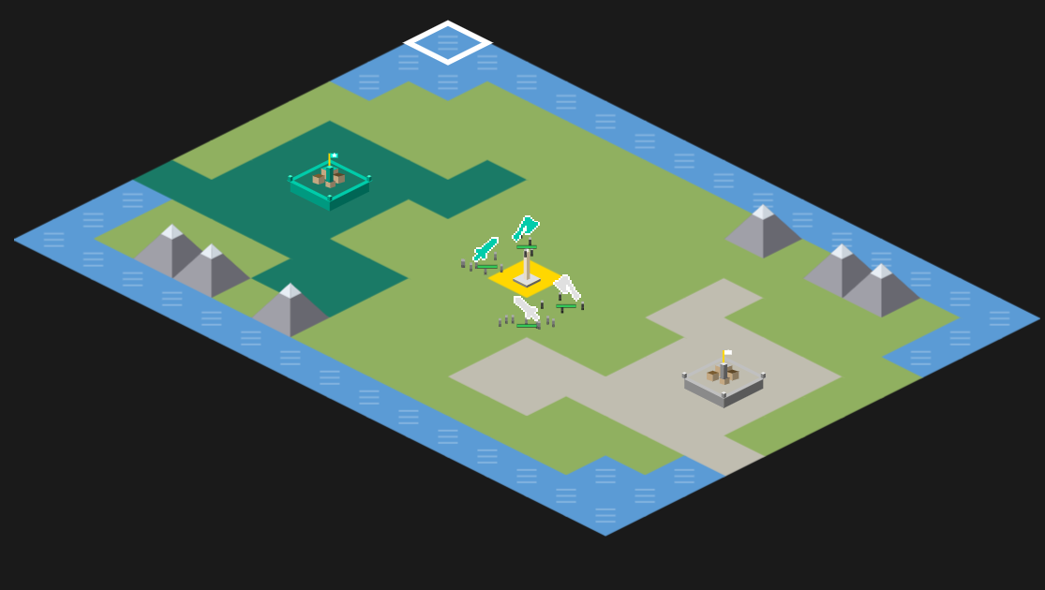
Map generation
Tournament map 3 lanes
Blitz map for testing

Slide 8


Special tiles
Monument
City
Tagged by a player
Built by player
+3 gold per turn
+score every turn 3 $⋅$ total num cities on map
+5 gold per turn
can build units
can be captured

Slide 9
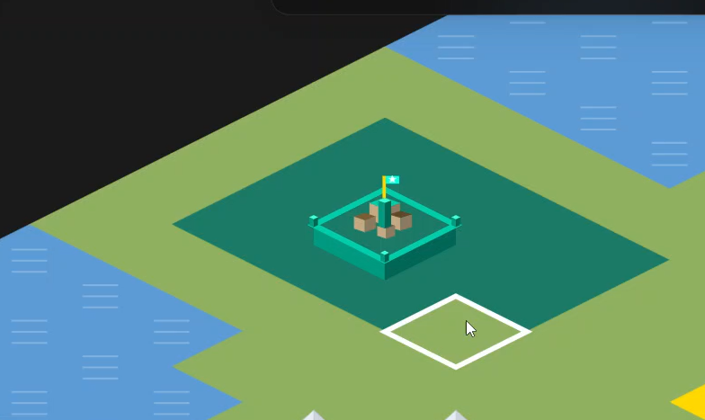
Actions
EXPAND_TERRITORY (x,y)
BUILD_CITY (x,y)
BUILD_UNIT city (x, y), type
MOVE (x1, y1) -> (x2, y2)

Slide 10



Units
Raider (15G)
HP: 1
Damage: 1
Movement: 2
Special: plunder
Soldier (20G)
HP: 2
Damage: 1
Movement: 1
Special: city capture, Zone of control
Archer (25G)
HP: 2
Damage: 1
Movement: 1
Special: Ranged

Slide 11
Showcase: Combat

Slide 12
Geometric upkeep
the more units and cities you have, the more expensive to build / maintain they are (50% more expensive next time)
1 unit per city is free
Excess units | 0 | 1 | 2 | 3 | 4 | 5
Upkeep / turn | 0 | 1G | 2.5G | 4.8G | 8.1G | 13.2G
City number | 1 | 2 | 3 | 4 | 5 | 6
Construction cost | 80G | 120G | 180G | 270G | 405G | 608G

Slide 13
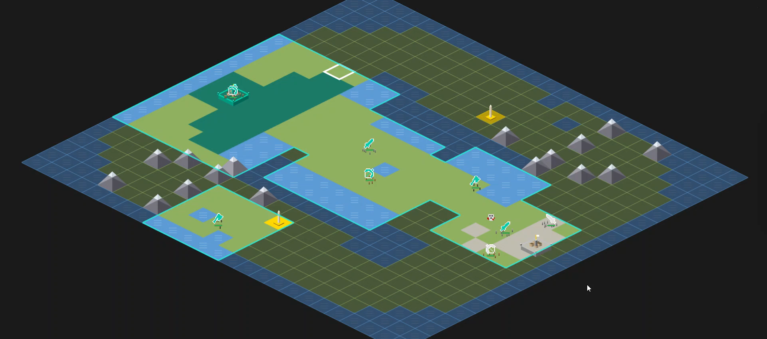
Fog of war

Slide 14
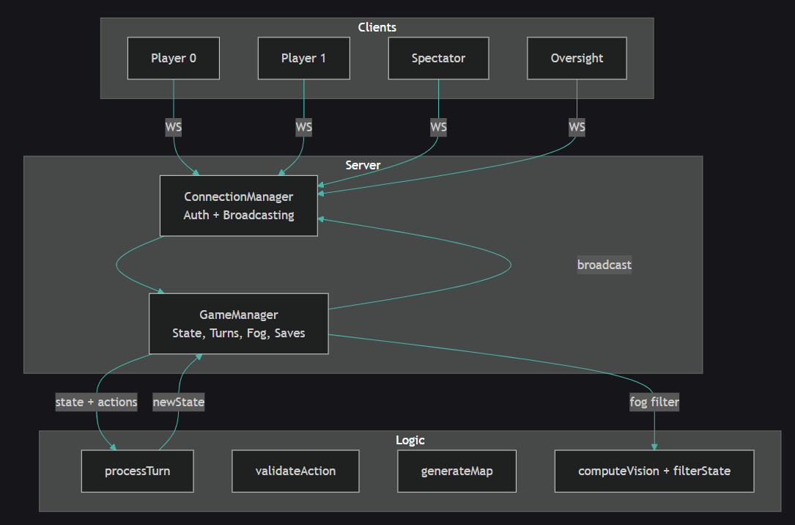

Server architecture

Slide 15
Web klijent
Rewinding past games
Manual play
Oversight mode
Special views
DEMO

Slide 16
Questions? (also, read the docs!)

